Slide 1
Digital Image Processing
Chapter 5: Image Restoration and Reconstruction

Slide 2
A Model of the Image Degradation/Restoration Process

Slide 3
Degradation
Degradation function H
Additive noise
Spatial domain
Frequency domain

Slide 4
Restoration

Slide 5
Noise Models
Sources of noise
Image acquisition, digitization, transmission
White noise
The Fourier spectrum of noise is constant
Assuming
Noise is independent of spatial coordinates
Noise is uncorrelated with respect to the image itself

Slide 6
Gaussian noise
The PDF of a Gaussian random variable, z,
Mean:
Standard deviation:
Variance:

Slide 7
70% of its values will be in the range
95% of its values will be in the range

Slide 8
Rayleigh noise
The PDF of Rayleigh noise,
Mean:
Variance:

Slide 9
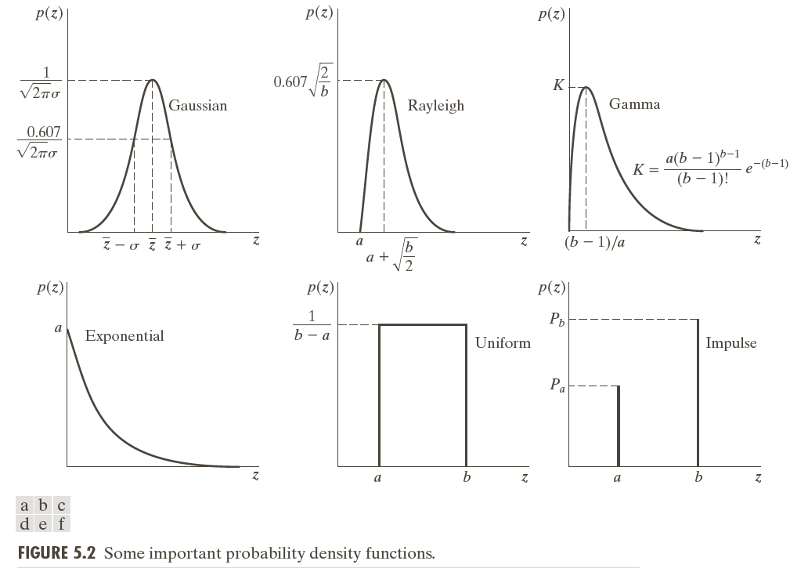

Slide 10
Erlang (Gamma) noise
The PDF of Erlang noise, , is a positive integer,
Mean:
Variance:

Slide 11
Exponential noise
The PDF of exponential noise, ,
Mean:
Variance:

Slide 12
Uniform noise
The PDF of uniform noise,
Mean:
Variance:

Slide 13
Impulse (salt-and-pepper) noise
The PDF of (bipolar) impulse noise,
: gray-level will appear as a light dot, while level will appear like a dark dot
Unipolar: either or is zero

Slide 14
Usually, for an 8-bit image, =0 (black) and =255 (white)

Slide 15
Modeling
Gaussian
Electronic circuit noise, sensor noise due to poor illumination and/or high temperature
Rayleigh
Range imaging
Exponential and gamma
Laser imaging

Slide 16
Impulse
Quick transients, such as faulty switching
Uniform
Least descriptive
Basis for numerous random number generators

Slide 20
Periodic noise
Arises typically from electrical or electromechanical interference
Reduced significantly via frequency domain filtering

Slide 21
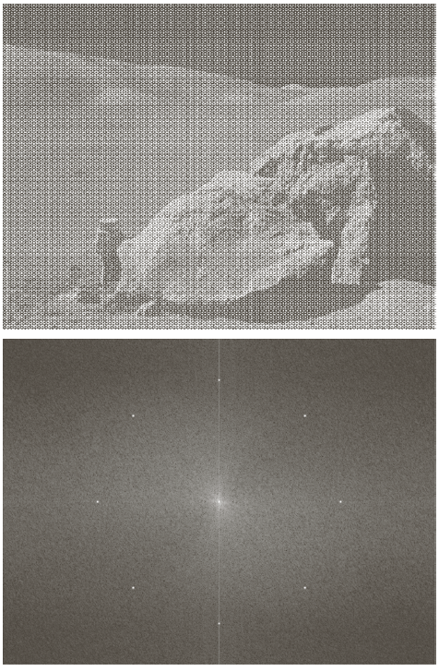
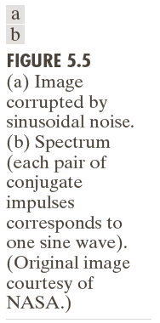

Slide 22
Estimation of noise parameters
Inspection of the Fourier spectrum
Small patches of reasonably constant gray level
For example, 150*20 vertical strips
Calculate , , , from

Slide 24
Restoration in the Presence of Noise Only-Spatial Filtering
Degradation
Spatial domain
Frequency domain

Slide 25
Mean filters
Arithmetic mean filter
Geometric mean filter

Slide 26
Harmonic mean filter
Works well for salt noise, but fails fpr pepper noise

Slide 27
Contraharmonic mean filter
: eliminates pepper noise
: eliminates salt noise

Slide 28
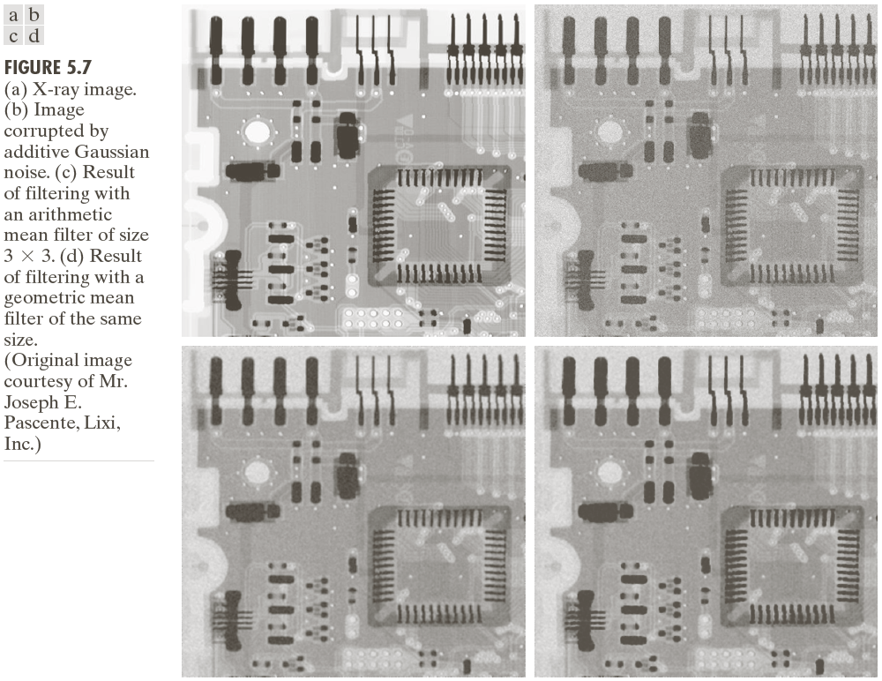

Slide 30
Usage
Arithmetic and geometric mean filters: suited for Gaussian or uniform noise
Contraharmonic filters: suited for impulse noise

Slide 32
Order-statistics filters
Median filter
Effective in the presence of both bipolar and unipolar impulse noise

Slide 33
Max and min filters
max filters reduce pepper noise
min filters salt noise

Slide 34
Midpoint filter
Works best for randomly distributed noise, like Gaussian or uniform noise

Slide 35
Alpha-trimmed mean filter
Delete the d/2 lowest and the d/2 highest gray-level values
Useful in situations involving multiple types of noise, such as a combination of salt-and-pepper and Gaussian noise

Slide 36
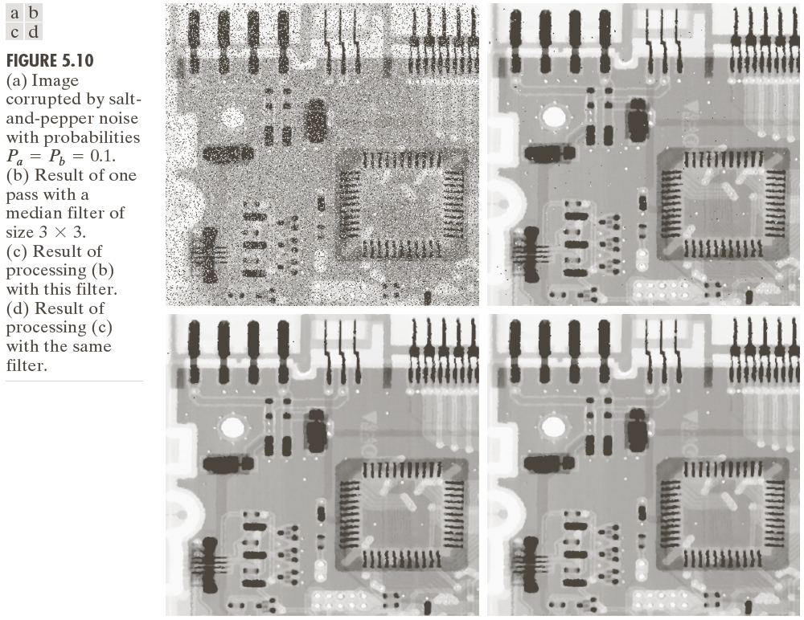

Slide 37
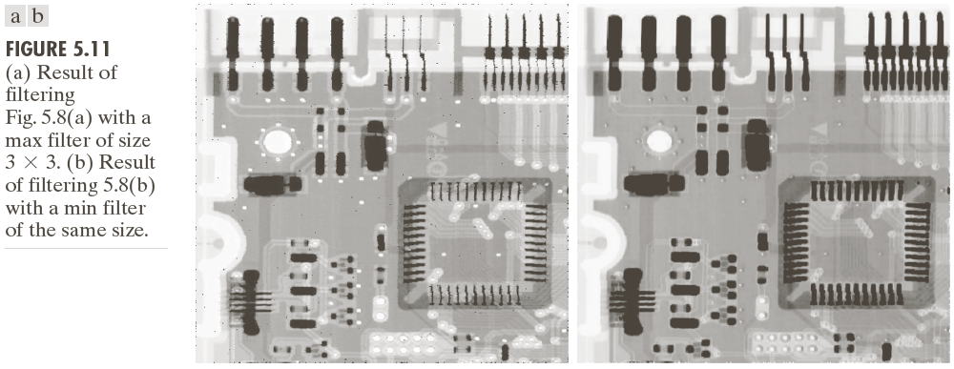

Slide 38
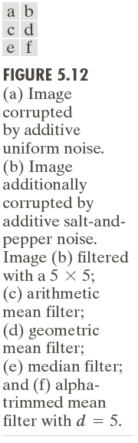

Slide 39
Adaptive, local noise reduction filter
If is zero, return simply the value of
If , return a value close to
If , return the arithmetic mean value

Slide 41
Adaptive median filter
= minimum gray level value in
= maximum gray level value in
= median of gray levels in
= gray level at coordinates
= maximum allowed size of

Slide 42
Algorithm:
Level A: A1=
A2=
If A1>0 AND A2<0, Go to
level B
Else increase the window size
If window size
repeat level A
Else output

Slide 43
Level B: B1=
B2=
If B1>0 AND B2<0, output
Else output

Slide 44
Purposes of the algorithm
Remove salt-and-pepper (impulse) noise
Provide smoothing
Reduce distortion, such as excessive thinning or thickening of object boundaries

Slide 46
Periodic Noise Reduction by Frequency Domain Filtering
Bandreject filters
Ideal bandreject filter

Slide 47
Butterworth bandreject filter of order n
Gaussian bandreject filter

Slide 50
Bandpass filters

Slide 51
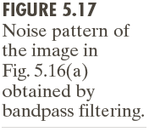

Slide 52
Notch filters
Ideal notch reject filter

Slide 53
Butterworth notch reject filter of order n

Slide 54
Gaussian notch reject filter

Slide 56
Notch pass filter

Slide 58
Optimum notch filtering

Slide 59
Interference noise pattern
Interference noise pattern in the spatial domain
Subtract from a weighted portion of to obtain an estimate of

Slide 60
Minimize the local variance of
The detailed steps are listed in Page 341
Result

Slide 63
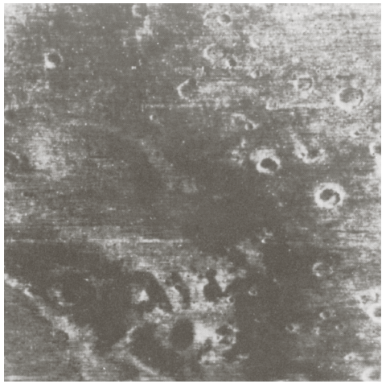

Slide 64
Linear, Position-Invariant Degradations
Input-output relationship

Slide 65
H is linear if
Additivity

Slide 66
Homogeneity
Position (or space) invariant

Slide 67
In terms of a continuous impulse function

Slide 69
Impulse response of H
In optics, the impulse becomes a point of light
Point spread function (PSF)
All physical optical systems blur (spread) a point of light to some degree

Slide 70
Superposition (or Fredholm) integral of the first kind

Slide 71
If H is position invariant
Convolution integral

Slide 72
In the presence of additive noise
If H is position invariant

Slide 73
If H is position invariant
Restoration approach
Image deconvolution
Deconvolution filter

Slide 74
Estimating the Degradation Function
Estimation by image observation
In order to reduce the effect of noise in our observation, we would look for areas of strong signal content

Slide 75
Estimation by experimentation
Obtain the impulse response of the degradation by imaging an impulse (small dot of light) using the same system settings
Observed image
The strength of the impulse

Slide 77
Estimation by modeling
Hufnagel and Stanley
Physical characteristic of atmospheric turbulence

Slide 79
Image motion

Slide 81
Where

Slide 82
If and

Slide 83
If and

Slide 84
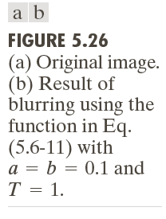

Slide 85
Inverse Filtering
Direct inverse filtering
Limiting the analysis to frequencies near the origin

Slide 87
Minimum Mean Square Error (Wiener) Filtering
Minimize
Terms
= degradation function
= complex conjugate of
=

Slide 88
= power spectrum of the noise
= power spectrum of the undegraded image

Slide 89
Wiener filter

Slide 90
Signal-to-noise ratio

Slide 91
Mean square error

Slide 92
White noise

Slide 94


Slide 95
Constrained Least Squares Filtering
Vector-matrix form
, , :
:

Slide 96
Minimize
Subject to

Slide 97
The solution
Where is the Fourier transform of the function

Slide 99
Computing by iteration
Adjust so that

Slide 100
Computation

Slide 101
Algorithm
1: Specify an initial value of
2: Compute
3: Stop if is satisfied; otherwise return to Step 2 after increasing if or
decreasing if .

Slide 103
Geometric Mean FIlter

Slide 104
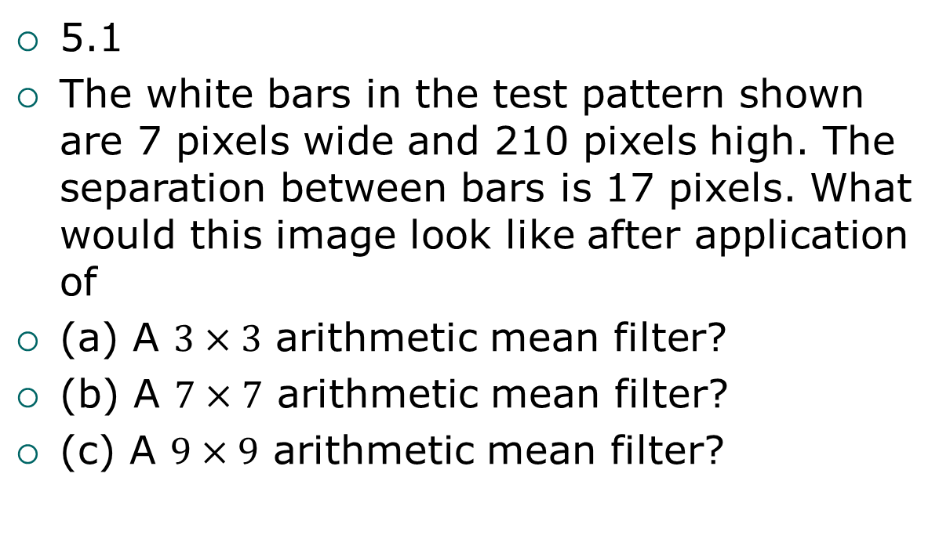
Problems
5.1
The white bars in the test pattern shown are 7 pixels wide and 210 pixels high. The separation between bars is 17 pixels. What would this image look like after application of
(a) A $3×3$ arithmetic mean filter?
(b) A $7×7$ arithmetic mean filter?
(c) A $9×9$ arithmetic mean filter?

Slide 105
Problems
5.1
The white bars in the test pattern shown are 7 pixels wide and 210 pixels high. The separation between bars is 17 pixels. What would this image look like after application of
(a) A $3×3$ arithmetic mean filter?
(b) A $7×7$ arithmetic mean filter?
(c) A $9×9$ arithmetic mean filter?

Slide 106

Problems
5.1 continued

Slide 107
Problems
5.3
Repeat Problem 5.1 using a harmonic mean filter.

Slide 108
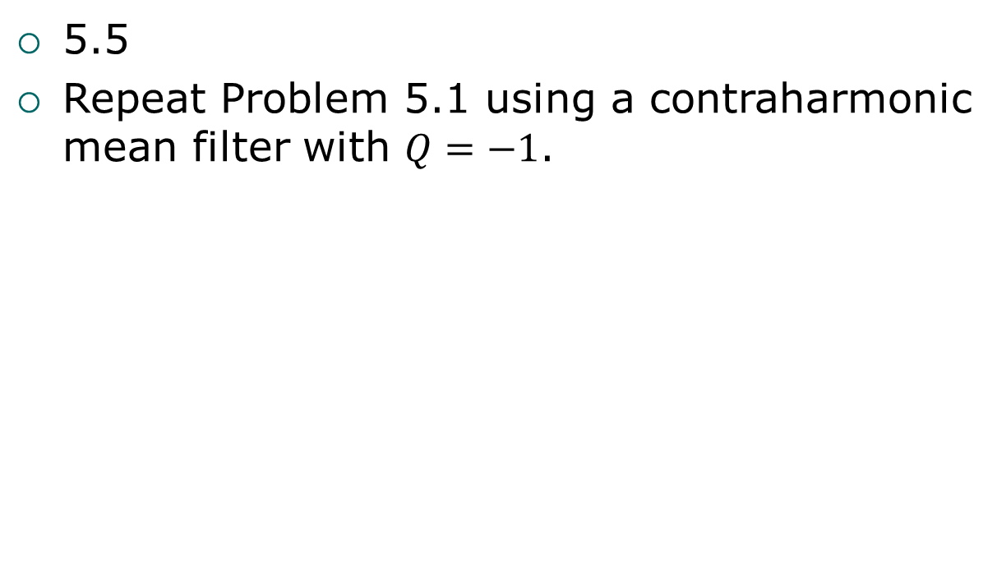
Problems
5.5
Repeat Problem 5.1 using a contraharmonic mean filter with $Q=−1$.

Slide 109
Problems
5.7
Repeat Problem 5.1 using a max mean filter.

Slide 110
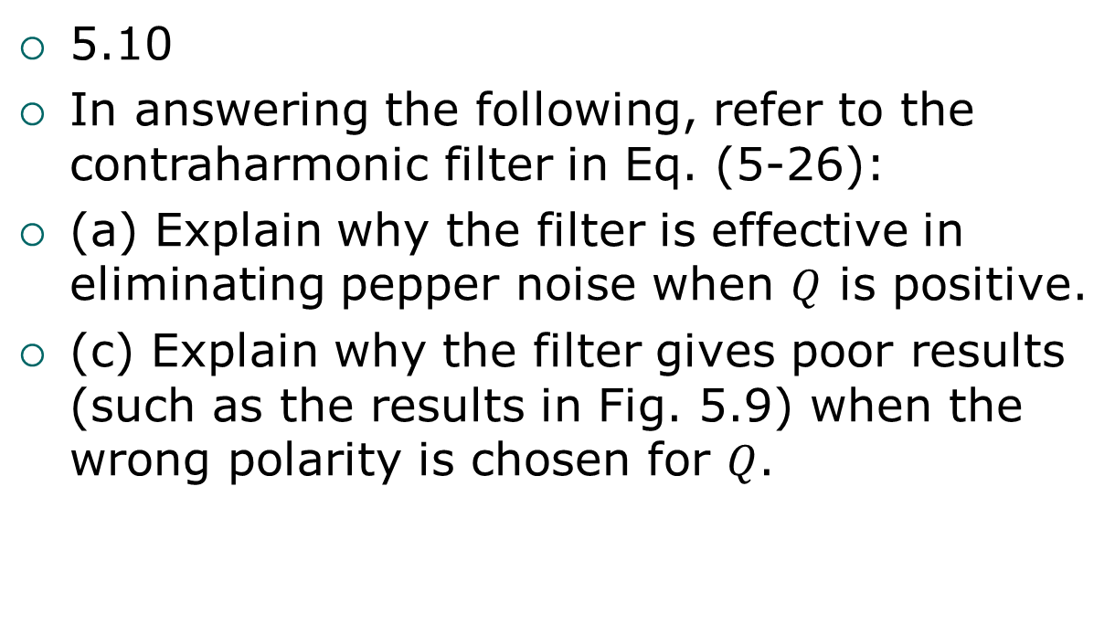
Problems
5.10
In answering the following, refer to the contraharmonic filter in Eq. (5-26):
(a) Explain why the filter is effective in eliminating pepper noise when $Q$ is positive.
(c) Explain why the filter gives poor results (such as the results in Fig. 5.9) when the wrong polarity is chosen for $Q$.

Slide 111
Problems
5.13
With reference to the bandreject filter transfer functions in Table 4.7, obtain equations for the transfer functions of:
(b) A Gaussian bandpass filter

Slide 112
Problems
5.14
With reference to Eq. (5-33), obtain equations for:
(a) An ideal notch filter transfer function

Slide 113
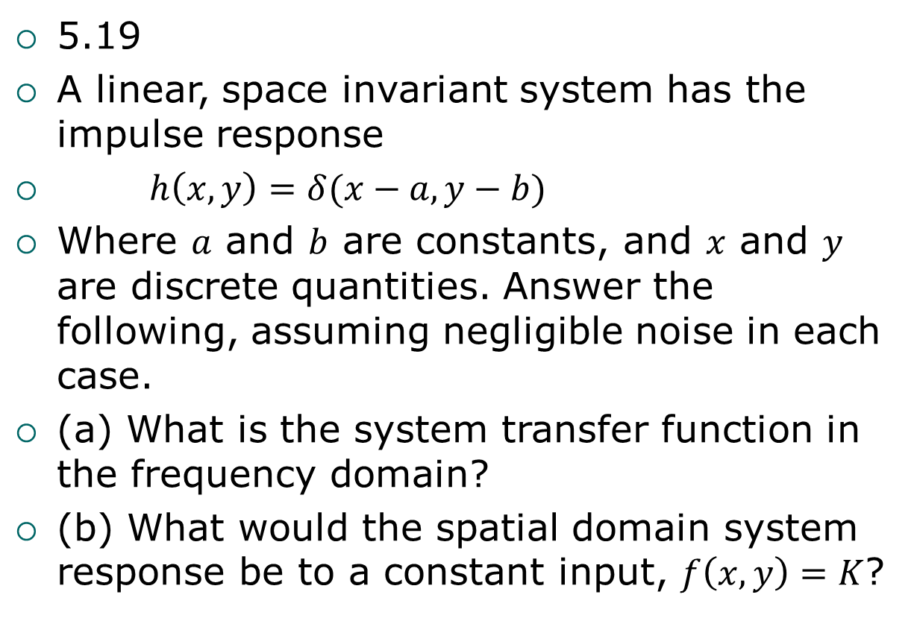
Problems
5.19
A linear, space invariant system has the impulse response
$h\left(x, y\right)=δ(x−a, y−b)$
Where $a$ and $b$ are constants, and $x$ and $y$ are discrete quantities. Answer the following, assuming negligible noise in each case.
(a) What is the system transfer function in the frequency domain?
(b) What would the spatial domain system response be to a constant input, $f\left(x, y\right)=K$?

Slide 114
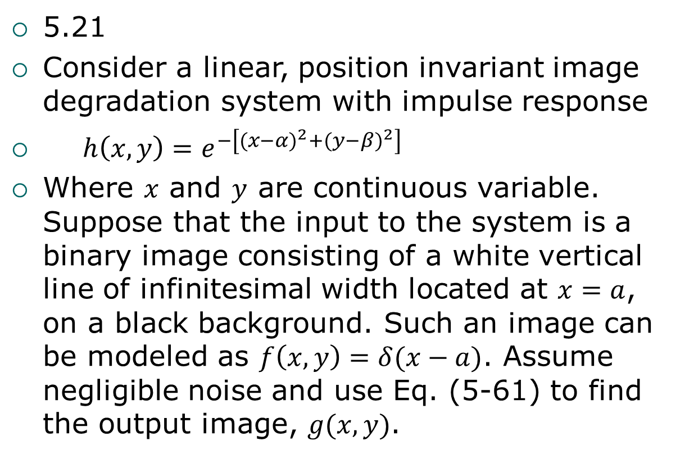
Problems
5.21
Consider a linear, position invariant image degradation system with impulse response
$h\left(x, y\right)=e^{−\left[{(x−α)}^{2}+{(y−β)}^{2}\right]}$
Where $x$ and $y$ are continuous variable. Suppose that the input to the system is a binary image consisting of a white vertical line of infinitesimal width located at $x=a$, on a black background. Such an image can be modeled as $f\left(x, y\right)=δ(x−a)$. Assume negligible noise and use Eq. (5-61) to find the output image, $g(x, y)$.

Slide 115
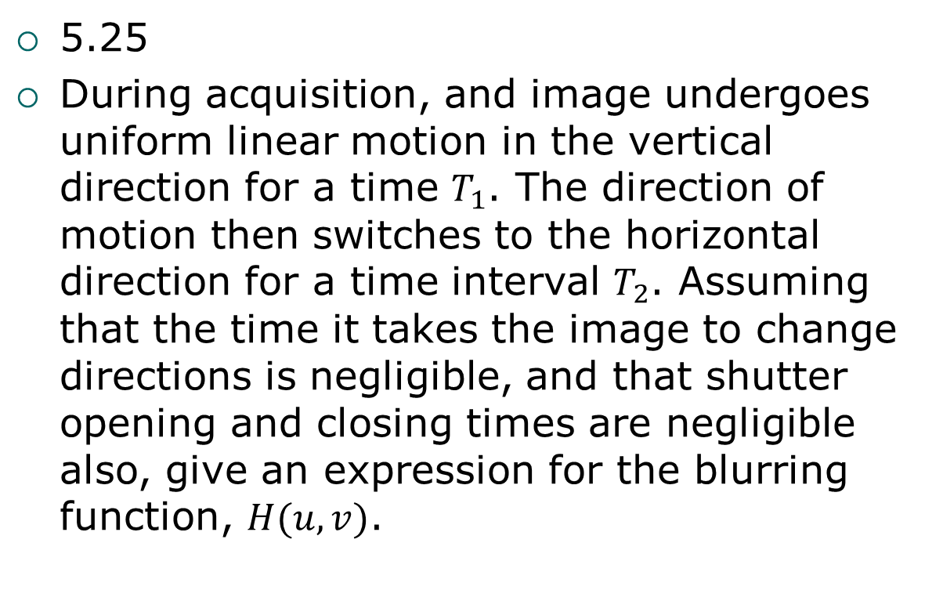
Problems
5.25
During acquisition, and image undergoes uniform linear motion in the vertical direction for a time $T_{1}$. The direction of motion then switches to the horizontal direction for a time interval $T_{2}$. Assuming that the time it takes the image to change directions is negligible, and that shutter opening and closing times are negligible also, give an expression for the blurring function, $H(u, v)$.

